Slide 1
THERMAL WATCH
Wireless Temperature Sensor

Slide 2
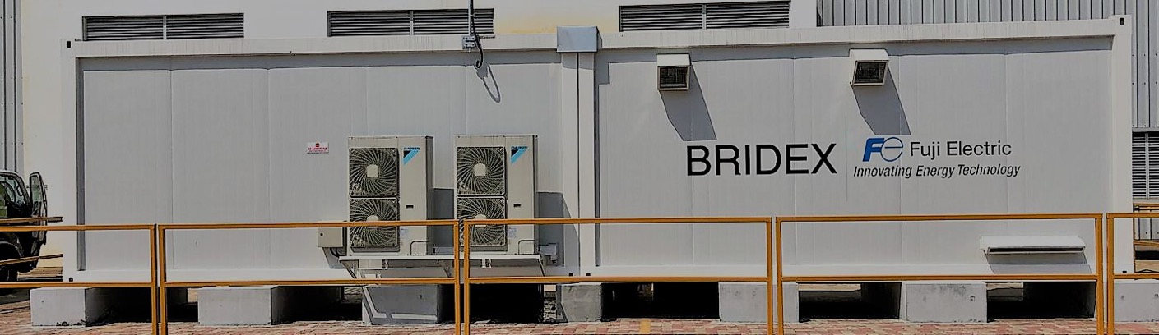
About Fuji Bridex
Founded in 1978, Fuji Bridex is a leading Industrial Solution & Services Provider in the Electrical, Power Quality and Energy Storage System market. Trusted by many customers in the Data Center, Power Utilities and Industrial market, we consistently develop our people and innovate our solutions to meet our client’s needs. Today acting as an Electrical Engineering, Procurement & Construction (EEPC) Contractor, we deliver construction and engineering projects, encompassing the entire project lifecycle from design, initial planning to construction and commissioning.
2

Slide 3
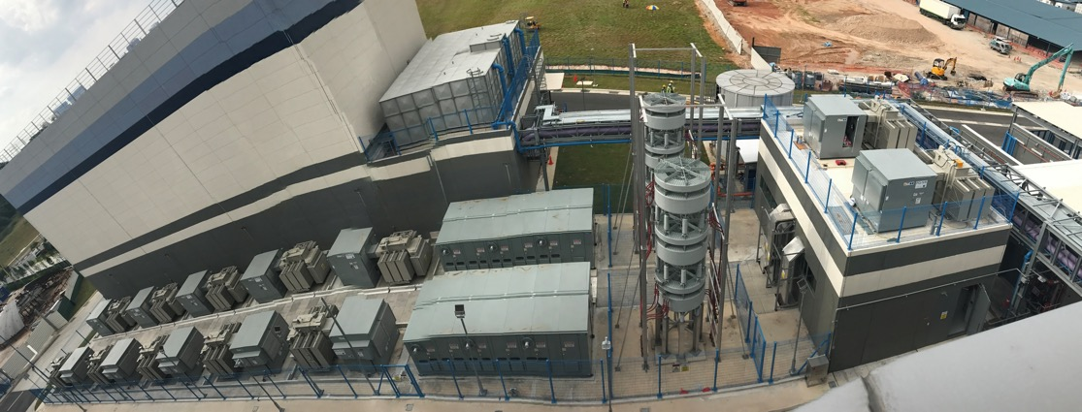
About Fuji Bridex
Vision – Be one of the leading EEPC companies in Southeast Asia’s industrial electrical market.
Mission – Dedicated to providing optimal solutions that will exceed customer’s specifications and requirements with below objectives:
Ensure the best EEPC competitiveness with Human Resource/Technology/Quality that meet international standards.
Continuously focus to improve HSE standards and minimize our ecological footprint.
Apply innovative solutions to deliver Fit-For-Purpose products and services.
Offer integrated services from conceptual design to final commissioning and start-up.
3

Slide 4





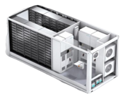




Fuji Bridex Integrated System Solutions
Power Quality
Up to 46kV Sag Mitigation Systems
Statcom / VVO
Batteries and Energy Storage
Battery Energy Storage Solution
Containerized/Custom Solution
Saltwater Battery
Natron Sodium-Ion Battery
Modular Infrastructure
HT / MV Transformers
Thermal Management
Industrial Cooling
Fire Prevention
Fire Suppression
Power Skid
4

Slide 5
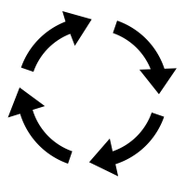






Not continuous measurement
Messy & complicated installation
No visual indication of the faulty location
Limitation of
current solutions
Not operative with forced ventilation
Not possible to test in real condition
Complicated setup
Wireless regulations
5

Slide 6


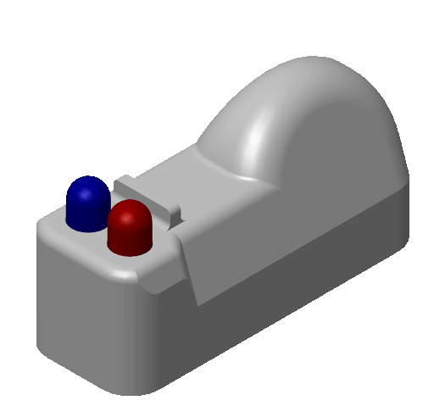
THERMAL WATCH
Wireless Thermal Sensor for Continuous Monitoring
SIMPLE OPERATION FOR USER
24/7 temperature monitoring
Real time temperature alerts
Visual indication of fault location
Digital display of fault location
EASY INSTALLATION & MAINTENANCE
Self-test on installation
Operative indoor and outdoor, IP68
Up to 6 meters communication
Install anywhere 7 x 12 x 24 mm device
No wiring - install in seconds
Communication setup free
License free signaling worldwide
SECURITY
Fail safe
Redundancy - two Independent temperature monitors
Operative till 125 ℃
Over 10 years lifespan guaranteed*
*for body temperature of sensor not exceeding 70 ℃
6

Slide 7

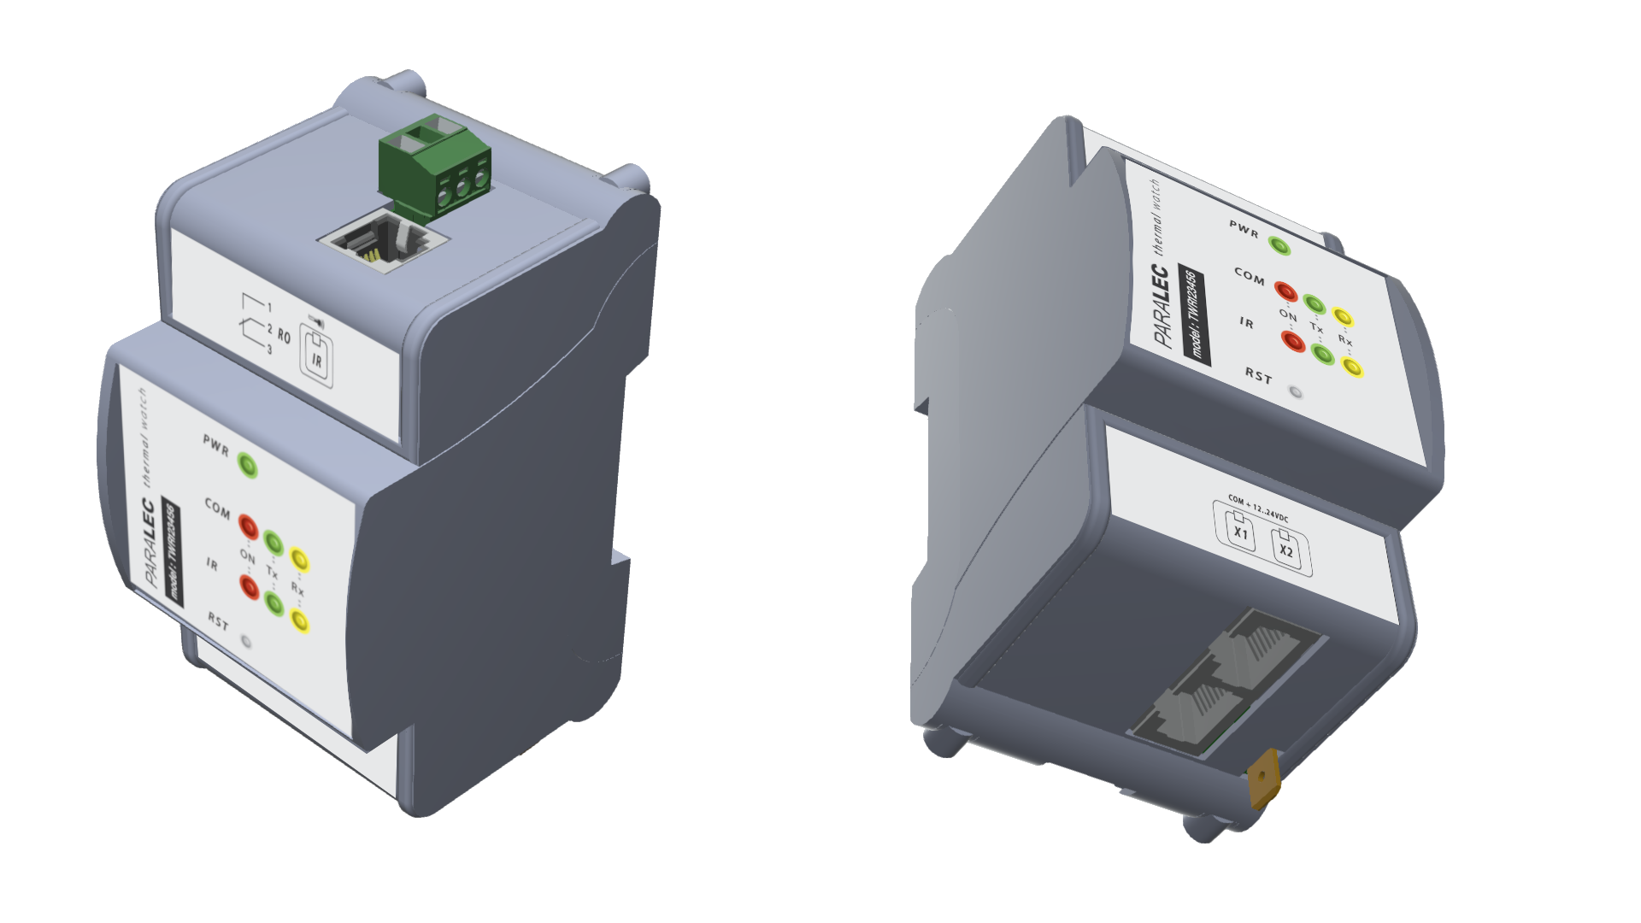
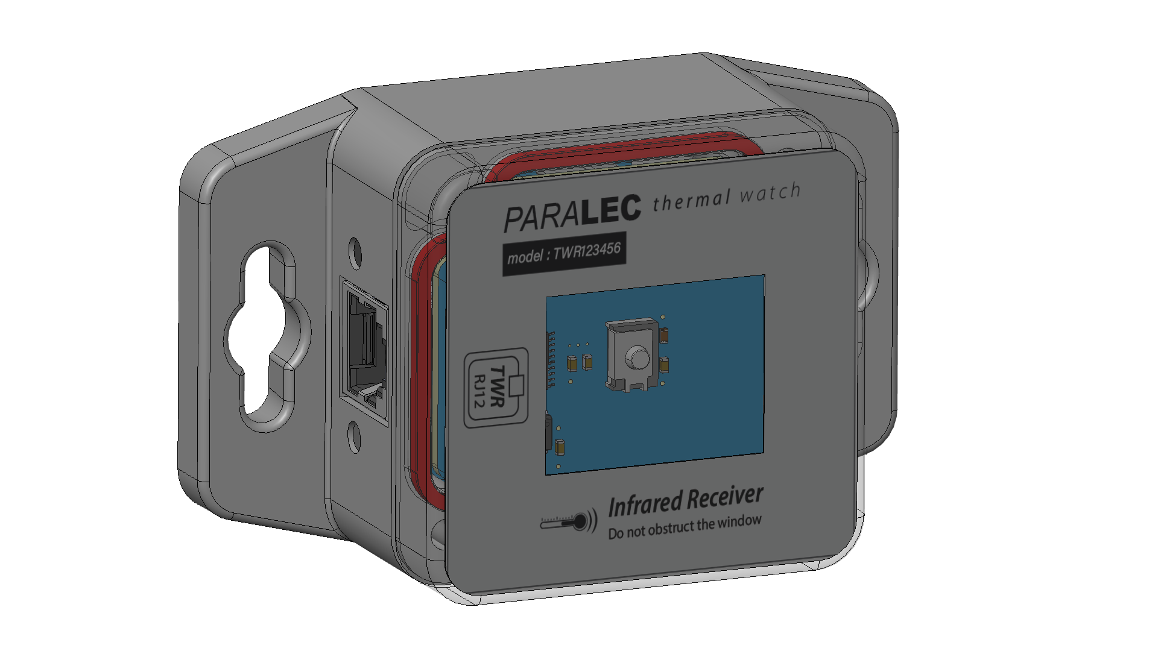
Overview System
THERMAL WATCH SENSOR - TWS
DIN Frame 1 modules receiving devices - TWR1
12 VDC
Digital output
RS485 MODBUS
LED output
X
IR Receiver
up to 6m
up to 50 TWS
DIN Receiver

Slide 8
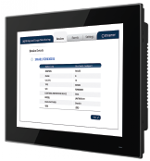
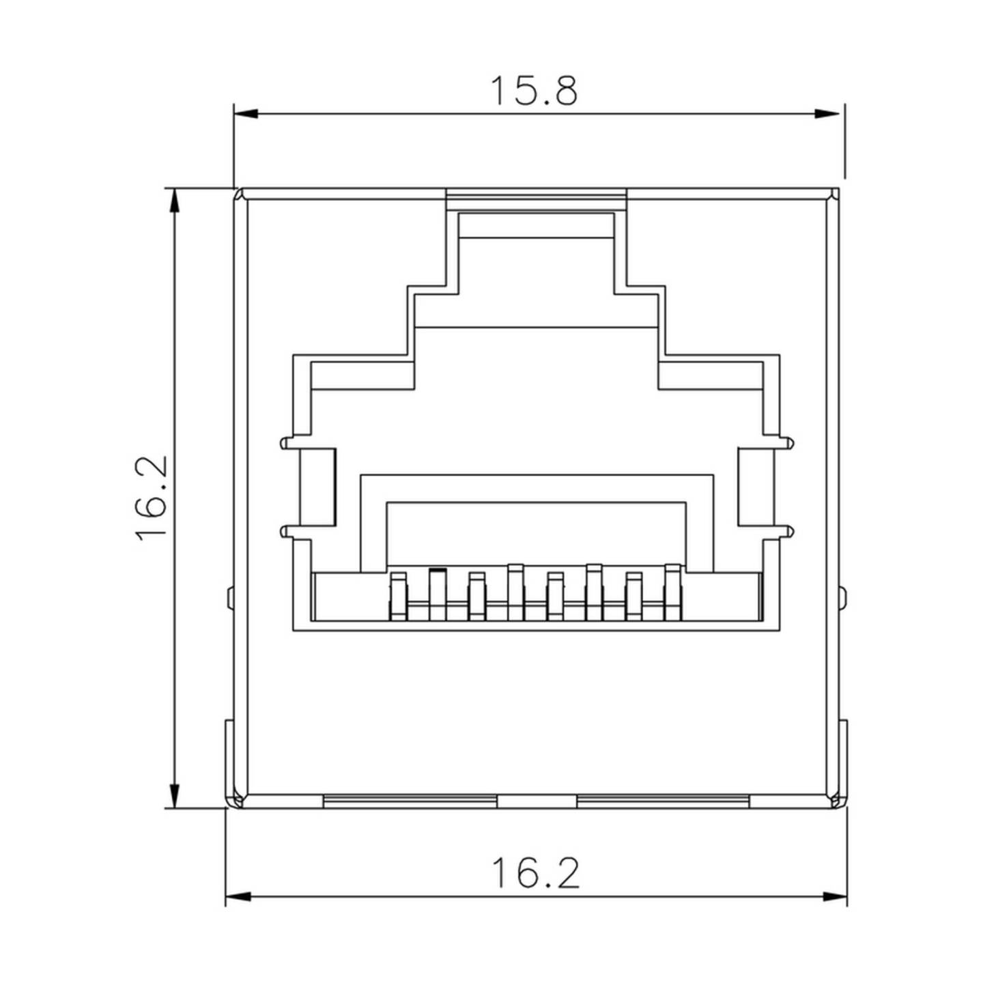
TWR Architecture DAISY CHAIN RS485
Communication with upper level
IR
Receiver
IR
Receiver
DIN Receiver
DIN Receiver
DIN Receiver
IR
Receiver
Data Concentrator
with / without HMI
LAN or WIFI connection
IEC61850 / DNP3 / MODBUS or REST API
CAT6 cable : RS485 + 12VDC
RJ45 PINS
1: RS485 +
2: RS485 -
3: GND
4:-
5:-
6:-
7: 12VDC+
8: 12VDC-

Slide 9
Thermal Watch - RECEIVER TWR
Dry contact output
For control / command
Mounting holes for easy installation
Hole slots
Connection for IR receiver
RJ12, up to 3m
ON & Communication
Green/Yellow LED indicator
ALARM
Red LED indicator
Communication & Power
RJ45 IN and OUT
Connection for IR DIN
RJ12, up to 3m
Cleanable receiver
Reset button
TWR1-DIN = DIN Receiver
TWR1-DIN = DIN Receiver
TWR1-IR = IR Receiver

Slide 10
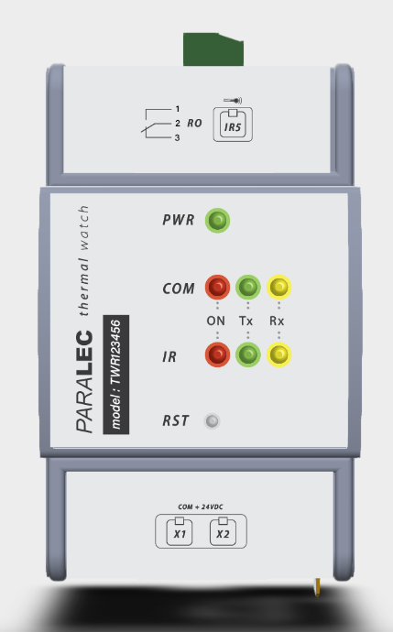
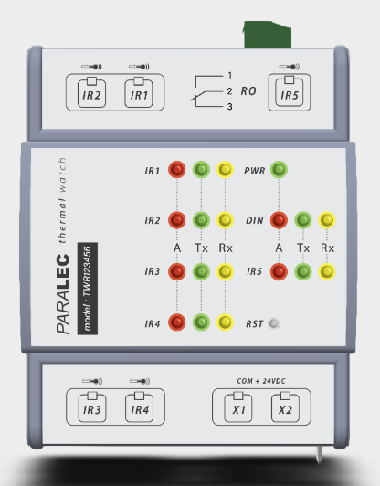
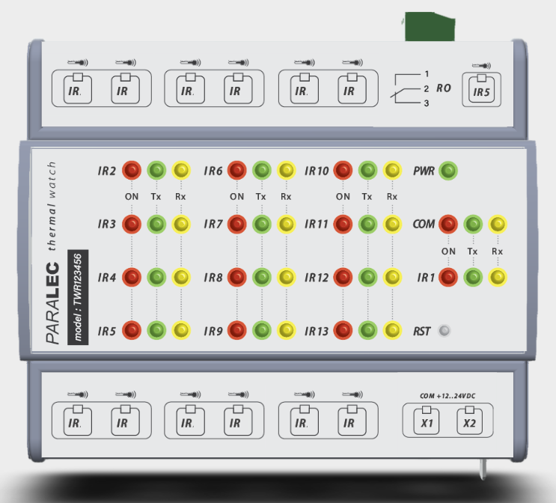
Thermal Watch - RECEIVER TWR
TWR1-DIN = 1 IR receiver
TWR5-DIN = 5 IR receivers
TWR13-IR = 13 IR Receivers

Slide 11
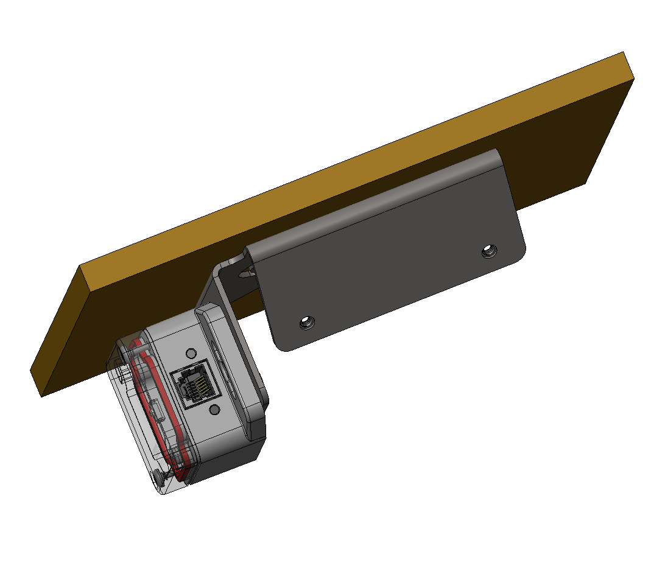
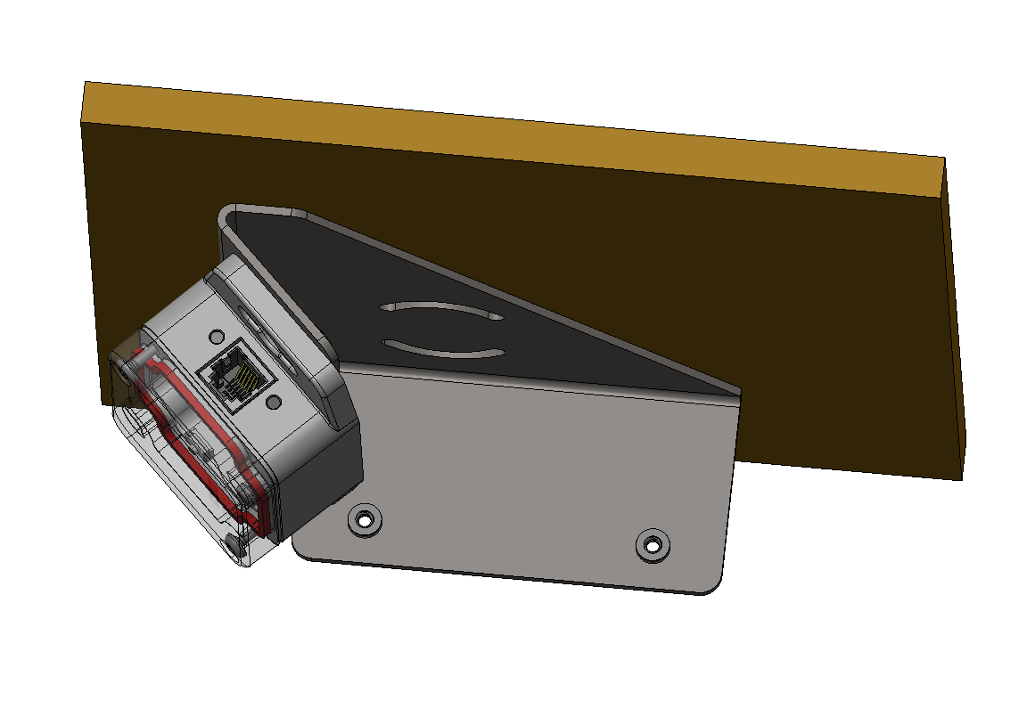
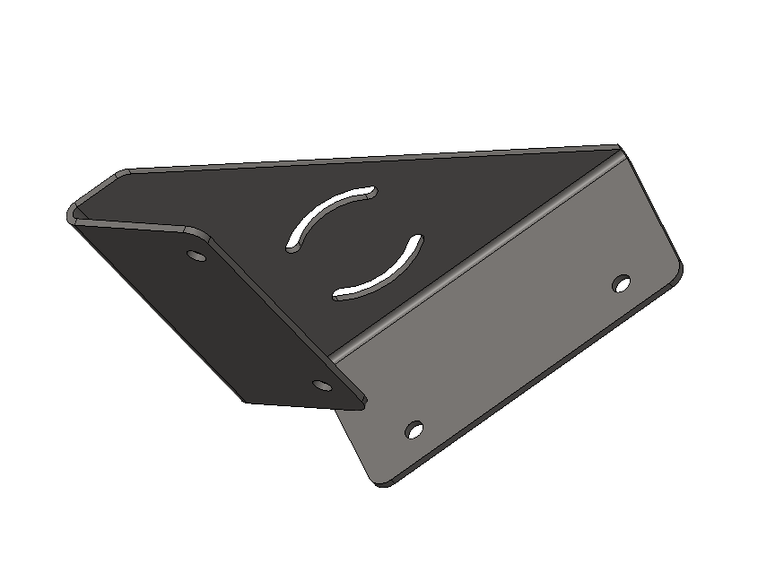
Thermal Watch - RECEIVER IR
Angle of 45*C
Rotation slot
90*
Angle of 90*C
45*C angle bracket
90*C angle bracket

Slide 12
Thermal Watch - SENSOR TWS
Models available :
TWS70, TWS90, TWS100
Strap
Wireless antenna
for communication up to 6m
Thresholds available* :
70℃, 90℃, 100℃
14 mm
Battery
>12 years at 80*C
>8 years at 100*C
Visual Red LED
allow user which
sensor is
triggered
4 operating modes
Test
Commissioning**
Alarm
Health Check
Testing pad
For test and
commissioning
Thermal Sensor N*1
from 0 to 125 *C
28 mm
Thermal Sensor N*2
70 or 90 or 100*C
9 mm
*thresholds are factory set
**available Q2 2024

Slide 13
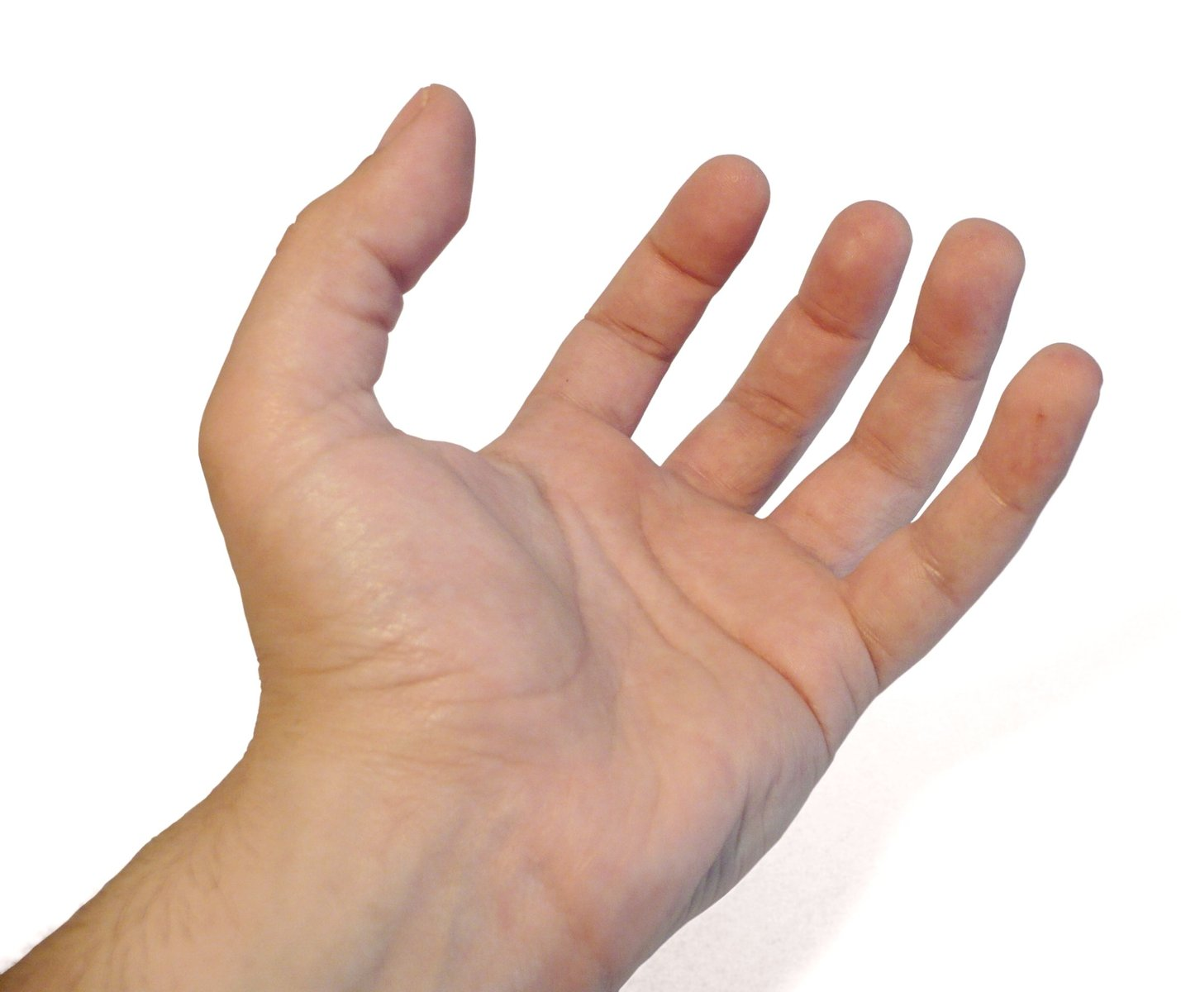
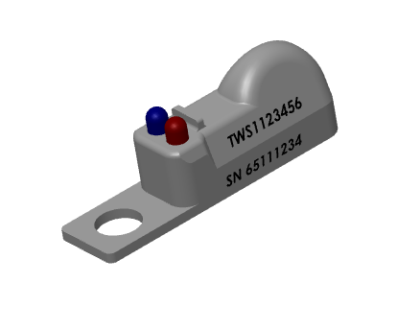
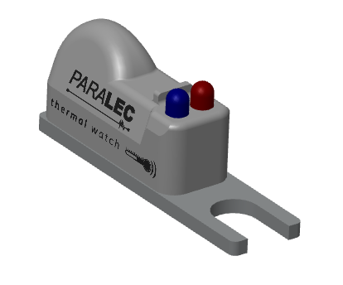
Thermal Watch - SENSOR TWS
3 mounting versions
Strap or cables ties
For limited access locations
For low diameter conductors
Metal mounting plate
with fork hole for M6 bolt
Aluminum plate for ideal heat transfer
Ideal for busbar
Molded mounting hole
In built M6 hole

Slide 14
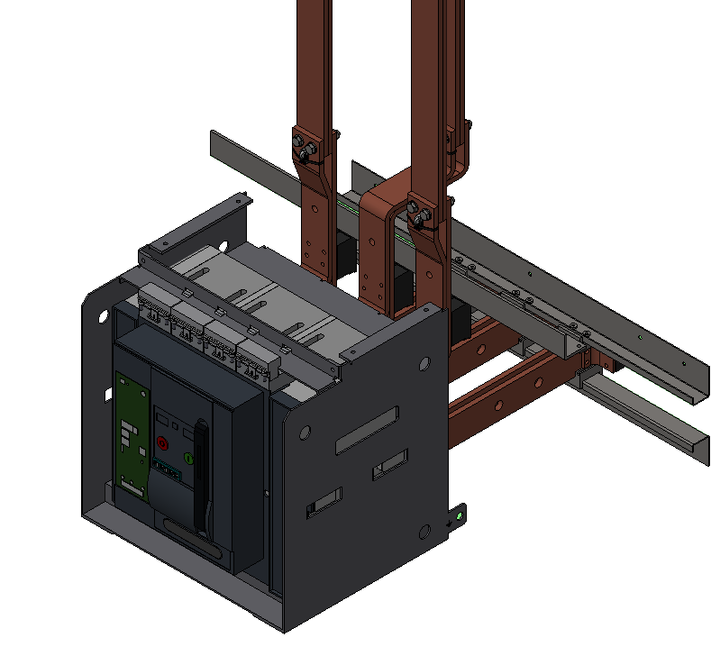
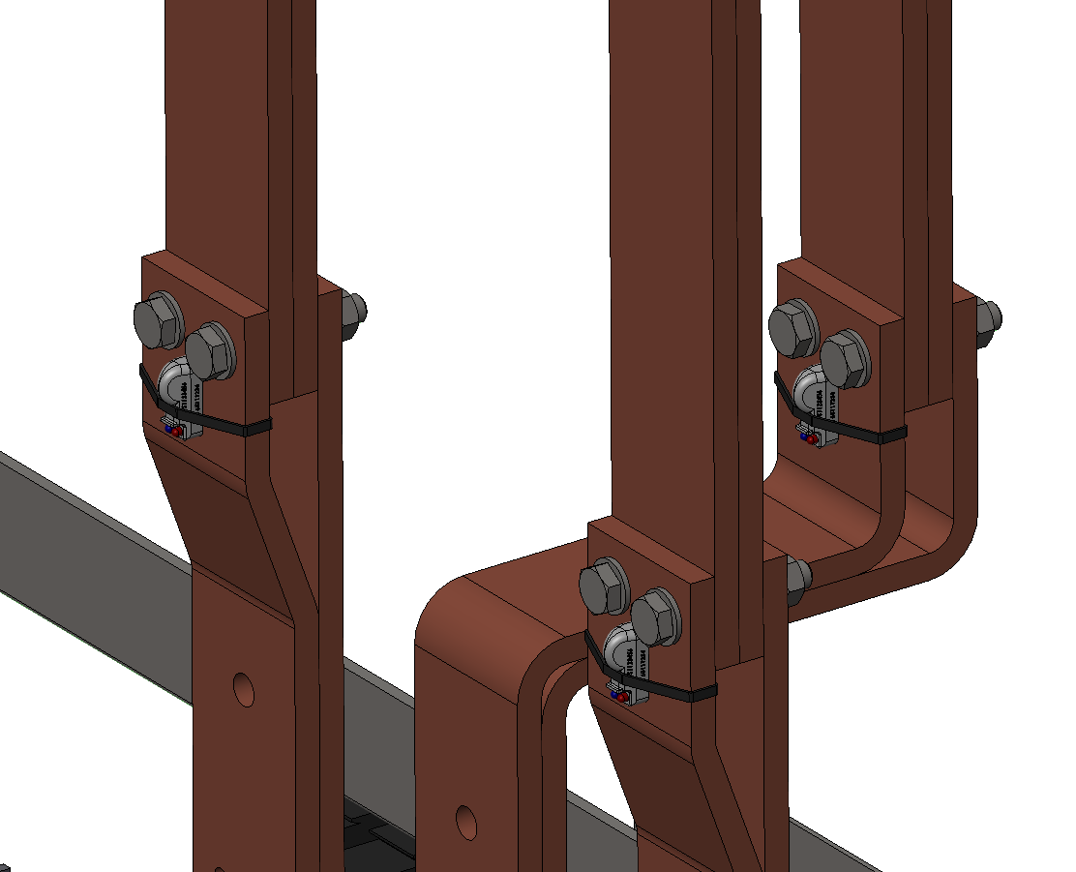
TWS Mounting
Cable Tie
TWS Sensor
Cable Lug
Rubber Sleeve

Slide 15


ALARM Mode
blinks for 30 mins
T℃ > Threshold
ID 00001
ID of device
Temperature *C
Mode
Battery left
00001
100℃
Alarm
OK

Slide 16



TESTING Sensor
1x short
1 second
ID 00001
For tests, LED emission is set at lowest battery
in order to simulate the “worst case”
ID of device
Temperature *C
Mode
Battery left
00001
82*C
Test
OK

Slide 17


COMMISSIONING**
**available Q2 2024
3x short
5+ seconds
closing panel 15 mins
ID 00001
For commissioning tests, LED emission is set at lowest battery
in order to simulate the “worst case”
ID of device
Temperature *C
Mode
Battery left
000001
82*C
Commissioning
OK

Slide 18
TEMPERATURE Reporting
2
1x short
2 hours*
ID 00001
ID of device
Temperature *C
Mode
Battery left
000001
82*C
Health Check
OK
*available in 1min, 30mins, 1h ou 2h

Slide 19
START Up
3x short
> 5 seconds

Slide 20
SLEEP Mode
1 second
> 15 seconds

Slide 21

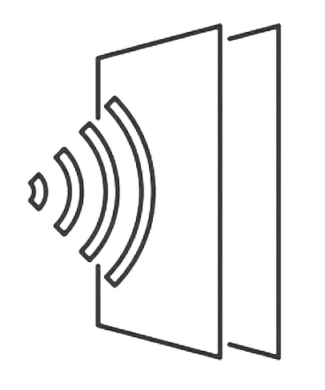
Communication
EYE OF SIGHT
Distance up to 6m eye of sight or indirectly
Operates in
up to 6m
Sensor
daylight* or in the dark
Receiver operates a dedicated algorithm to differentiate IR noise from signal
INDIRECT
Transmitted data
d1
ID of device
Temperature *C
Mode
Battery left
000001
82*C
Commissioning
OK
d2
d1+d2 : up to 6m
Sensor
*High infrared environment shall still be tested but due to filtering they can’t create nuisance alarm

Slide 22
InfraRED - COMMUNICATION
It provides adequate speeds—up to 16Mbps.
Infrared devices use less power and therefore don’t drain batteries as much.
Infrared is a secure medium. Infrared signals typically are a direct-line implementation in a short range and therefore do not travel far outside the immediate connection. This eliminates the problem of eavesdropping or signal tampering.
Infrared is a proven technology. Infrared devices have been available for some time and as such are a proven, nonproprietary technology with an established user and support base.
It has no radio frequency interference issues or signal conflicts.
It replaces cables for many devices, such as keyboards, mice, and other peripherals.
It uses a dispersed mode or a direct line-of-sight transmission.
Transmissions travel over short distances.
Advantages
Simple to implement
Low power consumption
Invulnerability to interference from traditional sources such as RF
Signals cannot be jammed (diffused)
User can move his/her station without reconfiguring the network
Infrared frequencies are free and available to anyone who wants to
use them
One time cost of equipment and installation

Slide 23
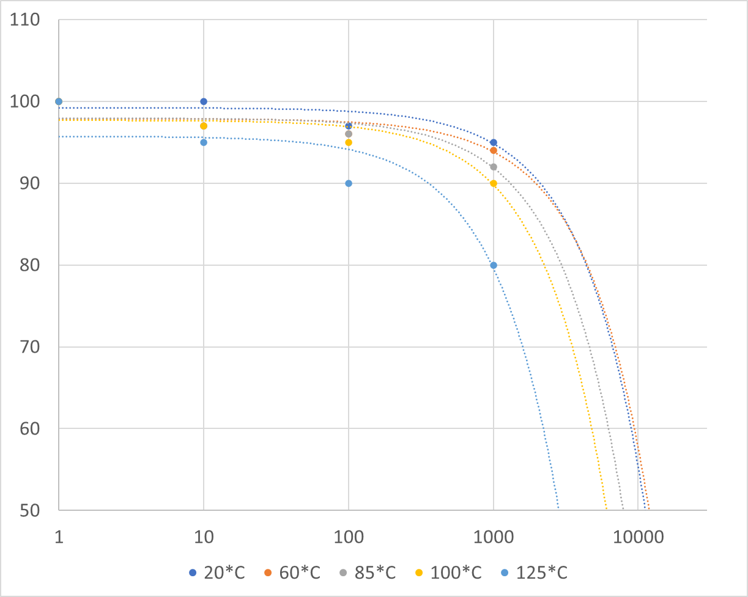
Power supply & Life expectancy
Power supply through battery
Real long duration tests have shown the following discharging trends
Discharge with 30k Ohm resistance and 2.5V cut off
Actual cut off is 1.8V
Device report battery level every 2 hours
Capacity retention / %
LIFE EXPECTANCY RESULTS
Up to 100*C : >10 years
125*C : > 6 years
Days

Slide 24
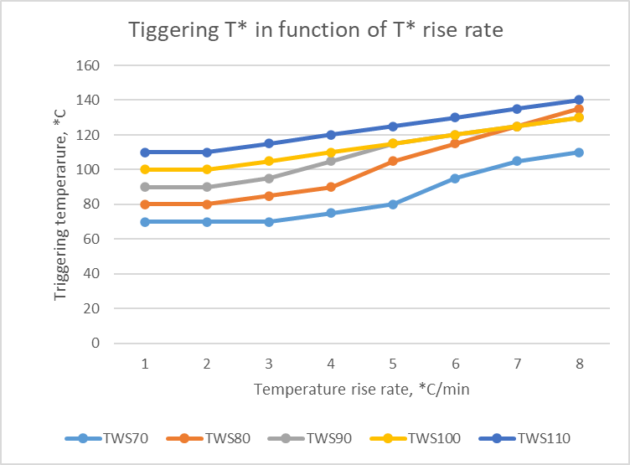
Triggering Time vs Temperature Rise Rate

Slide 25

Thermal Watch Sensor - Part Numbers
1091
_
_
_
_
_
_
TWS
5
6
7
8
9
10
5
6
7
8
9, 10
Temperature
Commissioning delay
Health check period
Mounting
Spare
1 : 100*C
2 : 90*C
3 : 70*C
1 : 15mins
2 : 30mins
3 : 5mins
1 : 2 hours
2 : 1 hour
3 : 30 mins
4 : 1 min
1 : strap
2 : metal plate
3 : embedded hole
11 : default

Slide 26
Thermal Watch Receiver - Part Numbers
1101
_
_
_
_
_
_
5
6
7
8
9
10
5
6
7
8
9, 10
Temperature
Number of corded sensors
Cable Length
Modbus Connector
Spare
1 : DIN-Receiver
2 : IR-Receiver
3 : RJ12 cables
4 : LAN CAT6 RJ45 cables
5 : Adapters
1 : 1 x IR receiver
2 : 5 x IR receivers
3 : 13 x IR receivers
1 : None
2 : 1m
3 : 2m
4 : 3m
1 : RJ45
2 : DB9
3 : Terminal
11 : default

Slide 27

Thermal Watch Concentrator - Part Numbers
1111
_
_
_
_
_
_
1
2
3
4
5
6
Spare
Spare
Spare
11 : All functions
12 : Simplified
11 : default
11 : default

Slide 28
Roadmap & Availability
Q3 2023
operating sample
for tests only
Q1 2024
Industrial and tested product
for sales
Q3 2024
TWS with commissioning
TWR with multiple receivers
TWC simplified
for sales
TWS1-test
TWR1-test
TWS1
1091 xxxxxx
TWR1
1101 111111
TWC
1111 111111
TWS2
1092 xxxxxx
TWR1
1101 121111
1101 131111
TWC
1111 121111

Slide 29
Exertherm Arguments against Wireless
Why are Exertherm Sensors hardwired, not wireless?
Why Thermal Watch answers these claims
The most important issue is that wireless sensors create a potential threat to critical infrastructure operations because such systems are hackable. Exertherm sensors avoid any cyber security risks
Infrared can’t be hacked, it is inside the cabinet ONLY
Sensors described as wireless often have a very limited transmission distance – sometimes as low as 30 cm (SAW technology).
6m, which also operate with bouncing signal
Wireless sensors require antenna to pick up the wireless signal –usually several antennas will be required per vertical column
True but a factor 6 to 10 as compared to Sensor
The antenna are hard wired !- so perceived savings are actually not available.
Antennas are much easier to deploy as even compared to Exerterm Sensors
Wireless sensors operate on a limited number of frequencies – which can result in confusion if antenna pick up two sensors on same frequency – causes commissioning problems
Solved at receiver level
The wireless systems can only normally be commissioned on-site
Clearly not for the IR sensors as they do not suffer from electromagnetic interferences
Wireless sensors require power to transmit the signal – that creates problems such as battery replacement costs / insufficient power to generate energy harvesting on LV equipment / requirement for re-calibration etc etc.
10Y and battery level at each communication!
Exertherm sensors avoid ALL these issues + Exertherm sensors come with a Lifetime Warranty/ zero maintenance guarantee – something wireless sensors cannot guarantee.
10Y and battery level at each communication!

